Slide 1
Crafting & Compelling Website Analysis, Audit and Recommendations
VIJAY KRISHNA S
MBT10

Slide 2
Introduction
Task – 1
Wipro: A Global Technology and Consulting Leader
Wipro Limited is a leading Indian multinational technology company that provides comprehensive information technology, consulting, and business process services worldwide.
Global Presence: Operates across various industries and geographies, serving clients around the globe.
Core Expertise: Specializes in helping businesses with digital transformation, leveraging technologies like AI, cloud, and data analytics.
Client-Centric Approach: Focuses on delivering innovative solutions that address clients' most complex challenges and drive their success.

Slide 3
Task – 2: Product and Service Descriptions
Wipro ai360: Transforming Business with AI-Infused Solutions
Wipro ai360 empowers businesses to leverage AI for significant growth and efficiency.
AI-Powered Innovation: Infuses AI across operations to drive innovation and optimize performance.
Data-Driven Decisions: Extracts actionable insights from data for smarter business choices.
Enhanced Efficiency: Automates tasks for greater operational efficiency and cost savings.

Slide 4
Task – 2: Product and Service Descriptions
Transform Enterprise Future with Wipro’s Business Process Services (BPS)
Wipro's BPS helps organizations streamline operations and achieve significant cost efficiencies through optimized processes.
Operational Excellence: Standardizes and simplifies processes for radical transformation.
Cost & Quality Optimization: Delivers significant cost reductions while maintaining high-quality service.
AI-Driven Automation: Integrates AI to further enhance efficiency and decision-making.

Slide 5
Task – 2: Product and Service Descriptions
Wipro Consulting Services 2025 | IT and Business Consulting Solutions
Wipro Consulting Services provides strategic advisory and implementation expertise to guide businesses through complex challenges and digital transformation.
Strategic Guidance: Offers high-level advice on business process improvement and IT strategy.
Digital Transformation: Accelerates adoption of cloud, AI, and other digital technologies.
End-to-End Solutions: Integrates consulting with Wipro's IT services for seamless execution.

Slide 6
Task – 2: Product and Service Descriptions
Sustainability Services - Transform Business with Wipro
Wipro's Sustainability Services help organizations embed environmental and social responsibility into their core business models.
Holistic Impact Management: Guides businesses in measuring, reducing, and managing their environmental footprint.
Decarbonization Journey: Supports the path towards net-zero emissions with strategic solutions.
Responsible Ecosystems: Builds reliable sustainability data and fosters responsible practices.

Slide 7
Task – 3: Website Platform Identification
Tool Used – Wappalyzer
CMS – Adobe Experience Manager
Analytics – Hotjar, Adobe Analytics, Microsoft Clarity, Linkedin Insight Tag, Google Analytics, Google Ads Conversion Tracking.
Security – reCAPTCHA, HSTS.
Programming Languages – Python, Java
Form Builders – Marketo Forms

Slide 8
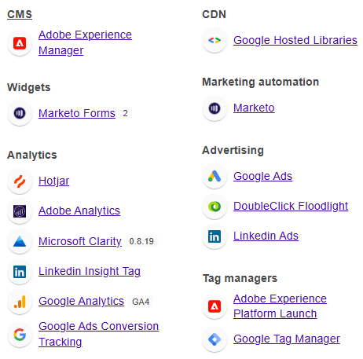
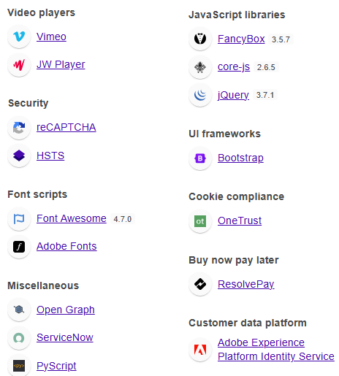
Task – 3: Website Platform Identification

Slide 9
Task – 4: Responsive Design Testing
Responsive Design testing is done by Plugin – Responsive Viewer
These are the five pages tested for Website’s Responsive Design and Mobile Optimization
  https://www.wipro.com/ai/
  https://www.wipro.com/business-process/
  https://www.wipro.com/consulting/
  https://www.wipro.com/analytics/
  https://www.wipro.com/sustainability/

Slide 10
Task – 5: Website Mistakes Identification
Cluttered Layout
  Homepage feels overcrowded with multiple competing content blocks
  Weak prioritization of important information
Slow Loading Times
  Desktop load speed ~2.3s; mobile score lower
  Images and scripts causing delays
Inconsistent Visual Hierarchy
  Headings and subheadings not clearly differentiated
  No clear focus or call-to-action path
Accessibility Concerns
  Poor contrast ratios, missing alt-text, and non-compliant navigation
  Lacks Universal Design principles (WCAG 2.1)
Suboptimal Mobile Experience
  Desktop layout compressed into mobile view
  Small tap areas and cluttered mobile interface reduce usability

Slide 11
Task – 5: Suggestions to Improve
Simplify Layout & Improve Readability
  Use whitespace and concise text
  Highlight a single primary message with strong CTAs
Optimize Performance
  Compress images, lazy-load below-the-fold content
  Minify JavaScript/CSS, implement CDN
Enhance Visual Hierarchy
  Use consistent fonts, spacing, and color to distinguish sections
  Guide users with a clear content flow
Improve Accessibility
  Comply with WCAG 2.1 AA standards
  Add alt-text, enhance contrast, and support screen readers
Strengthen Mobile Optimization
  Design mobile-first layouts
  Increase tap area size, remove desktop-dependent features

Slide 12
Task – 6: Best Practices List
User-Centric & Human-Centered Design
Focus on the needs, experiences, and behaviors of your users. Ensure navigation is intuitive, personalization is built-in, and inclusivity is a priority.
Simplicity & Clear Visual Hierarchy
Keep layouts clean and minimal, use white space effectively, and guide users’ attention to key actions or information using contrast, size, and spacing.
Mobile-First & Responsive Design
Design for all devices, with particular emphasis on mobile phones and tablets, ensuring layouts and interactions adapt seamlessly for any screen size.

Slide 13
Task – 7: Best Practices List
Fast Load Times & Performance Optimization
Optimize images and code to ensure quick site loading. Fast performance is critical for both usability and SEO.
Accessibility for All Users
Follow WCAG(Web Content Accessibility Guidelines): provide alt text, sufficient color contrast, keyboard navigation, and other features that make the website usable for everyone, including people with disabilities.

Slide 14
Task – 7: Landing Page Design
Created a landing page for the Wipro’s service with the goal of generating leads.
Innovate and Accelerate with wipro engineering
The Landing page is created with SEO Optimization and Mobile Responsive.

Slide 15
Thankyou

